Slide 1
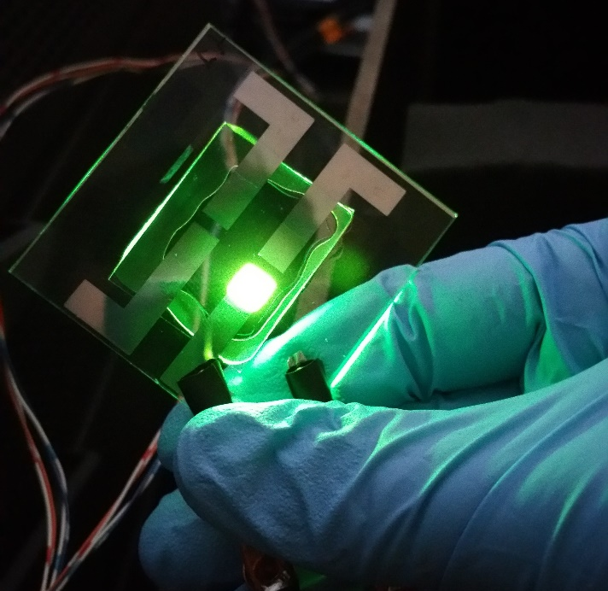
Understanding OLED Dynamics on Multiple Time Scales
Kyle W. Hershey
Department of Chemical Engineering & Materials Science
University of Minnesota, Minneapolis, MN
Funding provided by The Dow Chemical Company

Slide 2
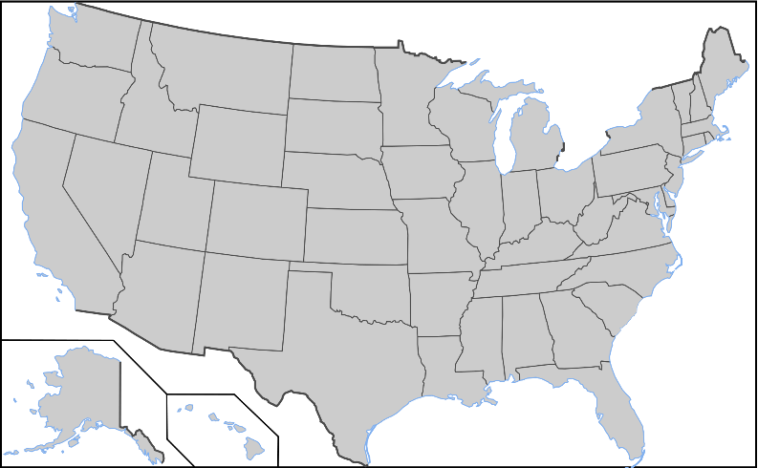


Personal Background
From:
Stoughton, WI
Undergraduate Education (2009-2013):
Coe College (Cedar Rapids, IA)
Majors:
Physics
Mathematics
Computer Science
Graduate Education (2013-Present):
University of Minnesota
Materials Science and Engineering
Advisor:
Prof. Russell Holmes
Research:
Organic Light Emitting Devices (OLEDs)
5
3
4
1
2

Slide 3
Outline
OLED background
Overview and applications
Operation
Challenges
Device Physics
Efficiency roll-off at high current
Transient electroluminescence
Analytical formalism for “charge balance”
Lifetime and Test Engineering
Degradation as efficiency loss
Extracting dynamics
Design rules for long lifetime
Data Engineering
Measurement system integration
Analysis Capabilities
Machine Learning

Slide 4
Outline
OLED background
Overview and applications
Operation
Goals
Device Physics
Efficiency roll-off at high current
Transient electroluminescence
Analytical formalism for “charge balance”
Lifetime and Test Engineering
Degradation as efficiency loss
Extracting dynamics
Design rules for long lifetime
Data Engineering
Measurement system integration
Analysis Capabilities
Machine Learning

Slide 5
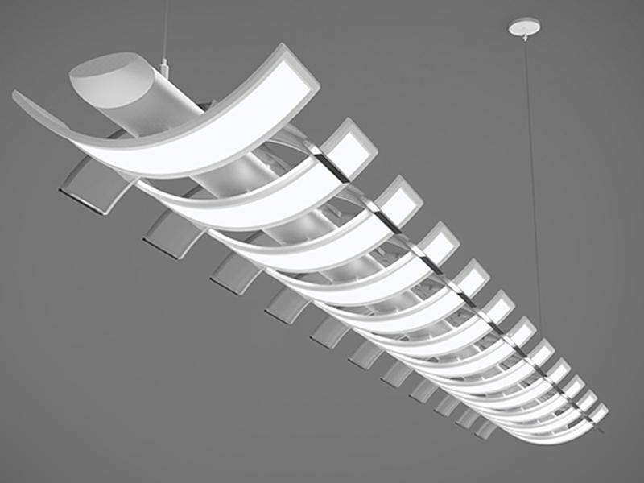
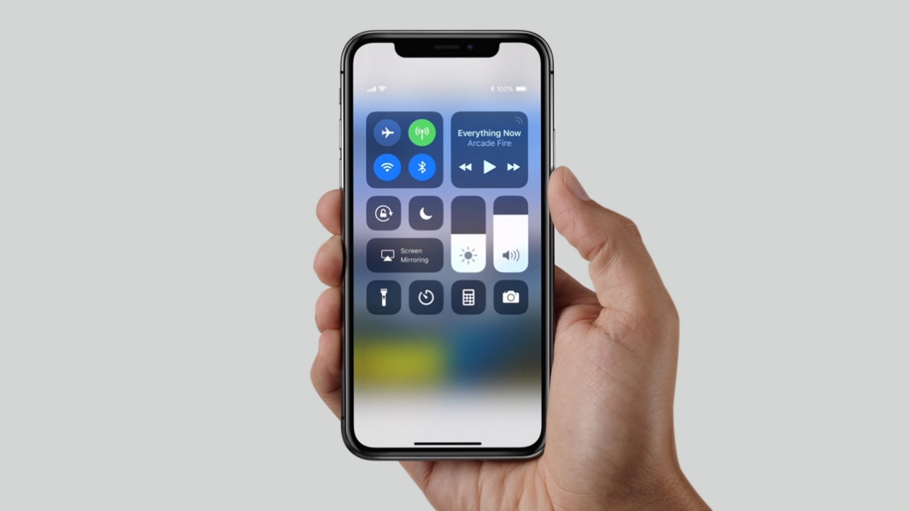
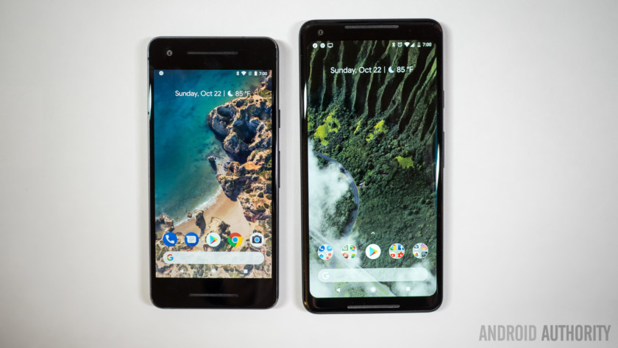
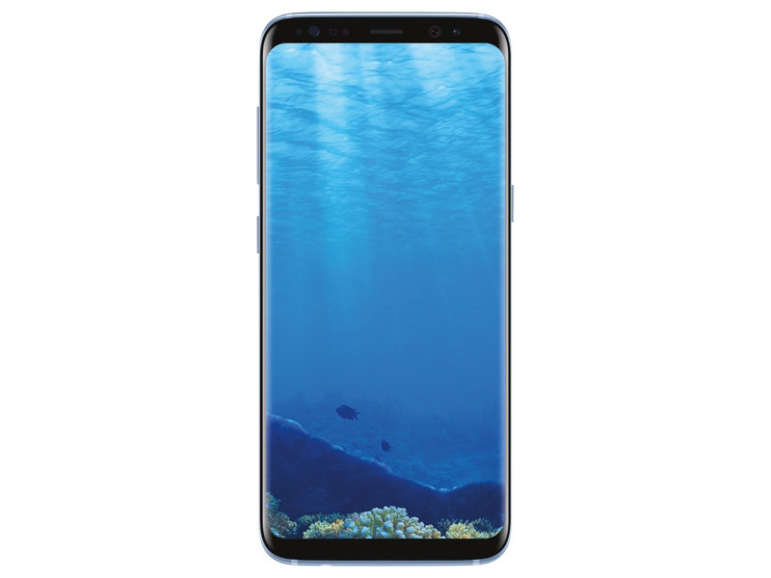
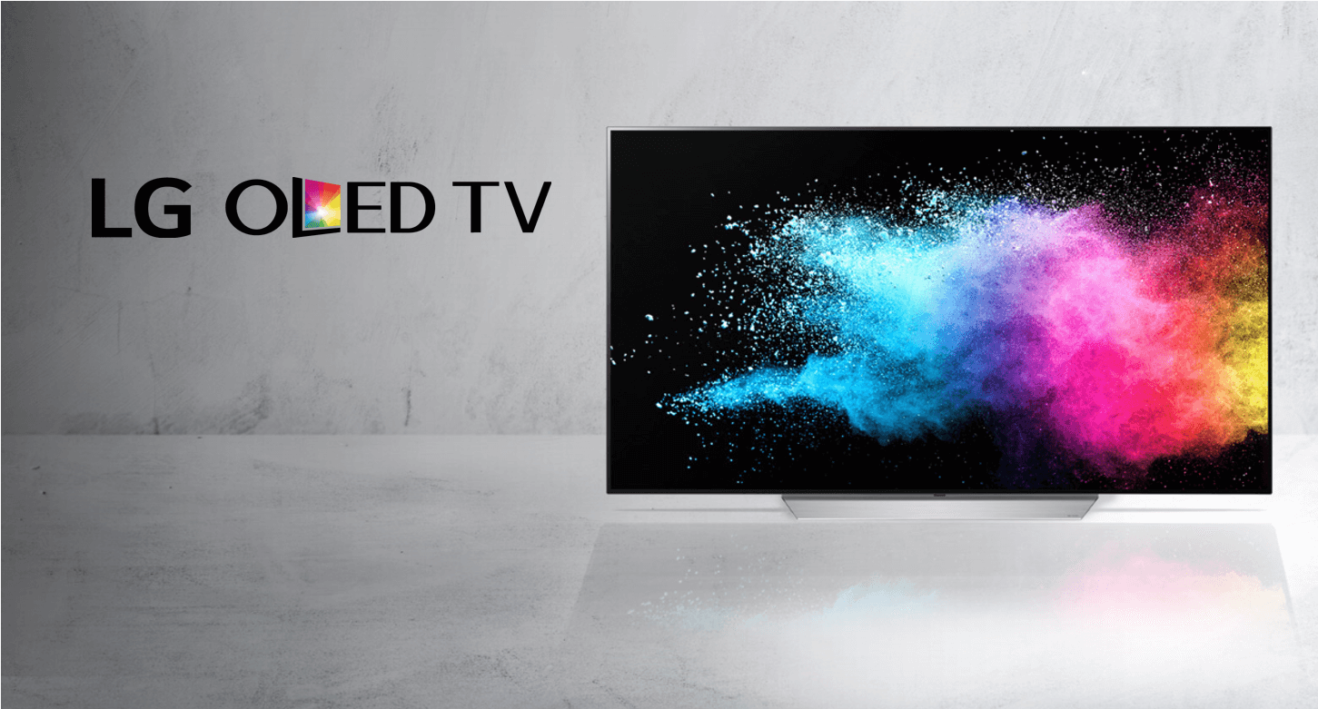
OLEDs
Highly Commercialized
Mobile displays
Large format displays
Architectural Solid-State Lighting
Unique Features
High efficiency
Unmatched contrast
Wide color gamut
Tunable emission
Thin form factor
Flexible substrate compatible
Acuity
Apple 2017
Google 2017
Samsung 2017
LG 2016

Slide 6
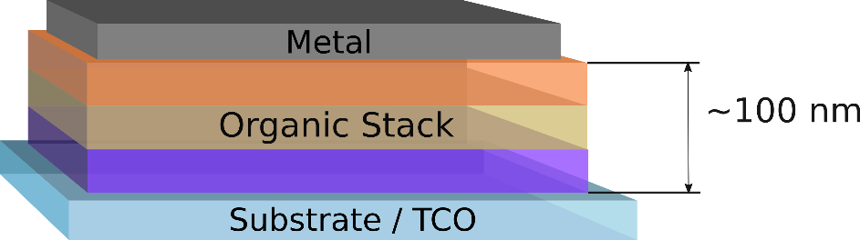
What are OLEDs?
Transparent conducting oxide (ITO) for light emission
Thin films produced with vacuum or solution processing
Organic conjugated small molecules
NPD
CBP
TPBi
Ir(ppy)₃
Alq₃

Slide 7
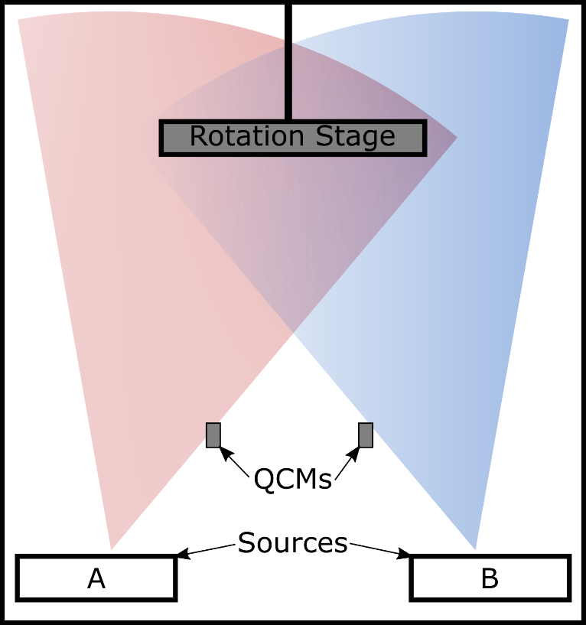
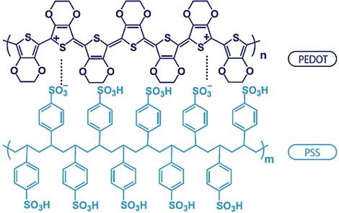
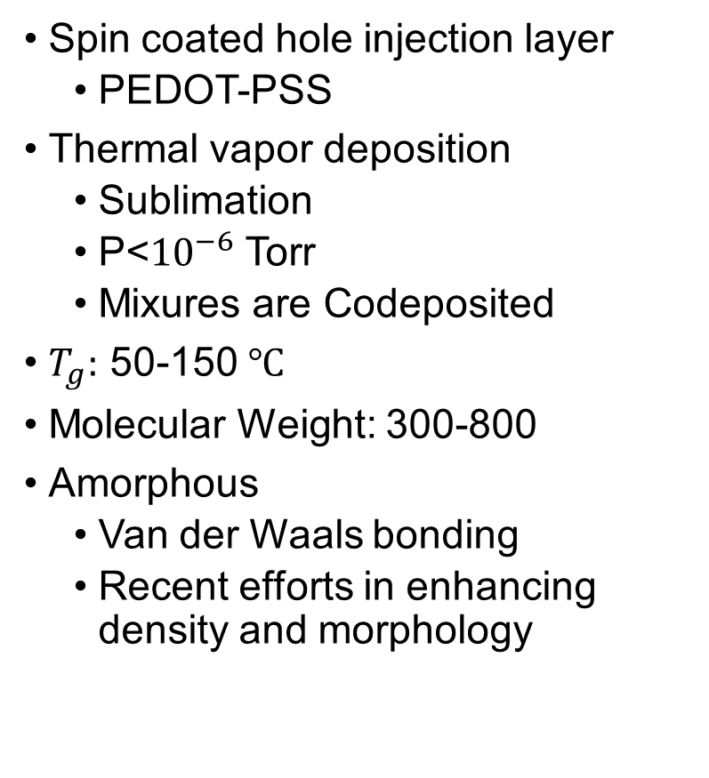
Films and processing
Spin coated hole injection layer
PEDOT-PSS
Thermal vapor deposition
Sublimation
P<${10}^{−6}$ Torr
Mixures are Codeposited
$T_{g}:$ 50-150 $℃$
Molecular Weight: 300-800
Amorphous
Van der Waals bonding
Recent efforts in enhancing density and morphology
http://advancedcoatings.nagasechemtex.co.jp/en/images/about/pedot_img.png

Slide 8
Organic Semiconductors
Conduction by hops between discrete molecules
Highest Occupied Molecular Orbital (HOMO)
Think valence band
Lowest Unoccupied Molecular Orbital (LUMO)
Think Conduction Band
Excitons
Coulombically bound electron-hole pair
Charges bound on single molecule
Lifetimes 10 ns – 100 ms
Main conceptual deviation from traditional LEDs
CBP

Slide 9
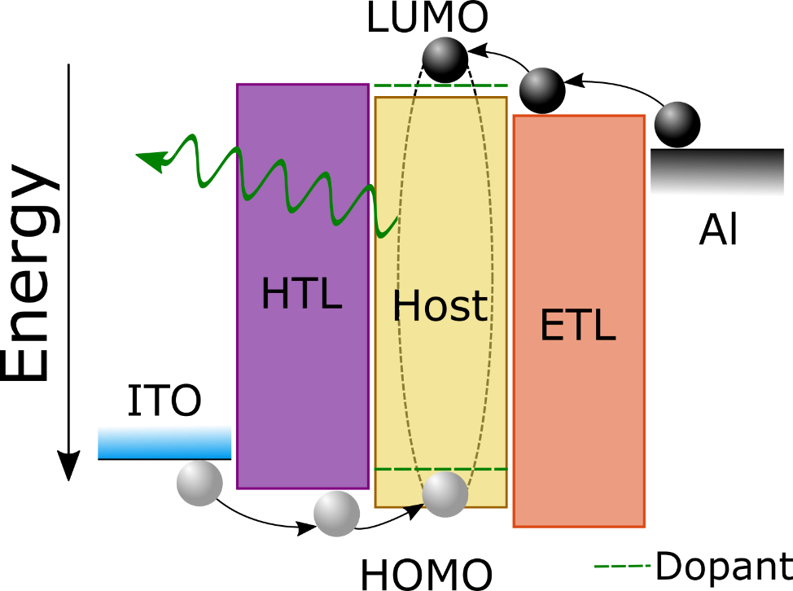
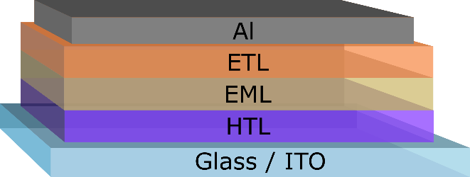
OLED Operation
Charges (polarons) move through transport layers (HTL/ETL)
Charges combine to form excitons
Emissive layer (EML)
Profile of exciton formation called recombination zone
Excitons emit light
Notes:
Molecultes primarily composed for carbon, nitrogen, hydrogen
Ir used for increased photoconversion efficiency

Slide 10
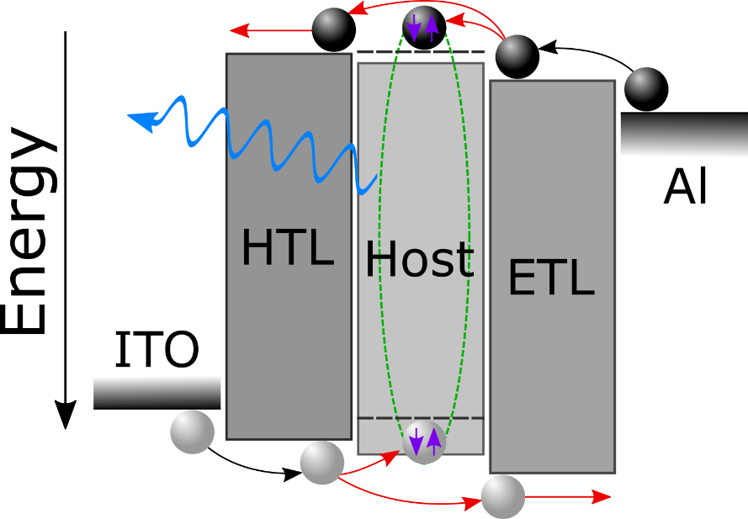
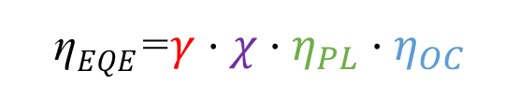
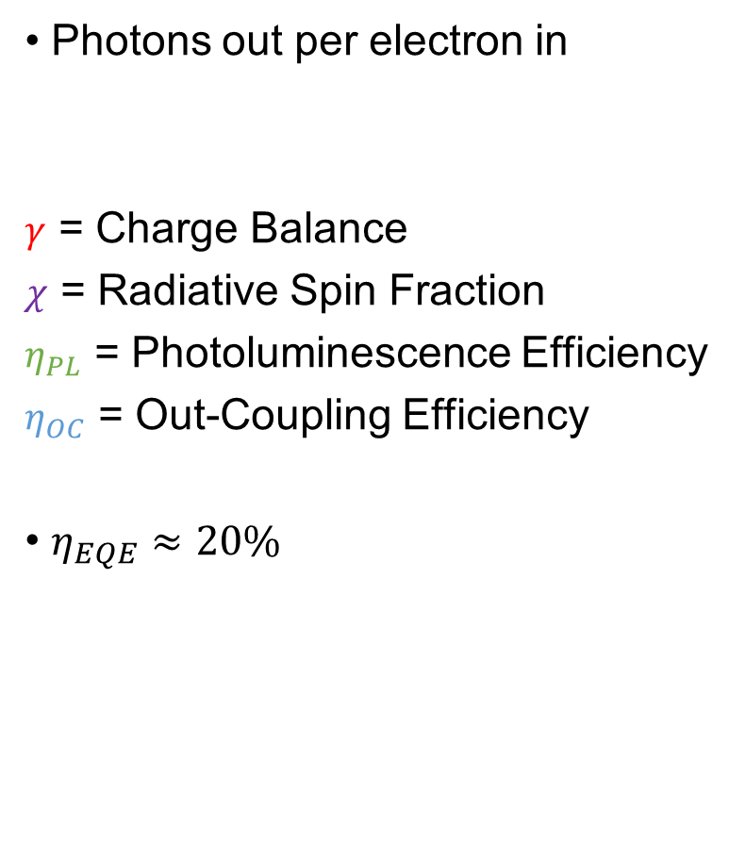
Efficiency Components
Photons out per electron in
$γ$ = Charge Balance
$χ$ = Radiative Spin Fraction
$η_{PL}$ = Photoluminescence Efficiency
$η_{OC}$ = Out-Coupling Efficiency
$η_{EQE}≈20\%$
η$EQE$=$γ⋅χ⋅η_{PL}⋅η_{OC}$

Slide 11
Active Research Fields
Focused on two problems:
Efficiency reduces at high brightness
Degradation over time
Steady-State
Lifetime
Roll-off
Both limited by understanding of kinetics

Slide 12
Outline
OLED background
Overview and applications
Operation
Goals
Device Physics
Efficiency roll-off at high current
Transient electroluminescence
Analytical formalism for “charge balance”
Lifetime and Test Engineering
Degradation as efficiency loss
Extracting dynamics
Design rules for long lifetime
Data Engineering
Measurement system integration
Analysis Capabilities
Machine Learning

Slide 13
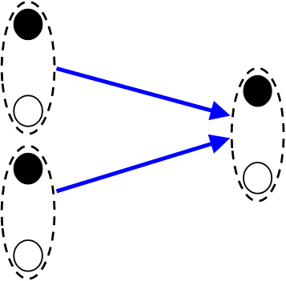
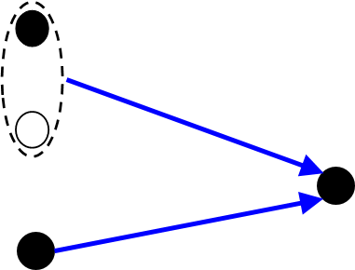
Motivation
Existing models predict efficiency roll-off using quenching
Magnitude unknown
Low current behavior not predicted
Existing Model is Incomplete
Exciton-Exciton Annihilation
Exciton-Polaron Quenching

Slide 14
Further Limitations
Typically only analyzed in steady-state
Dynamics are also expressed in transient voltage response
Existing model fails in this regime
Steady-State
Transient
Roll-off

Slide 15
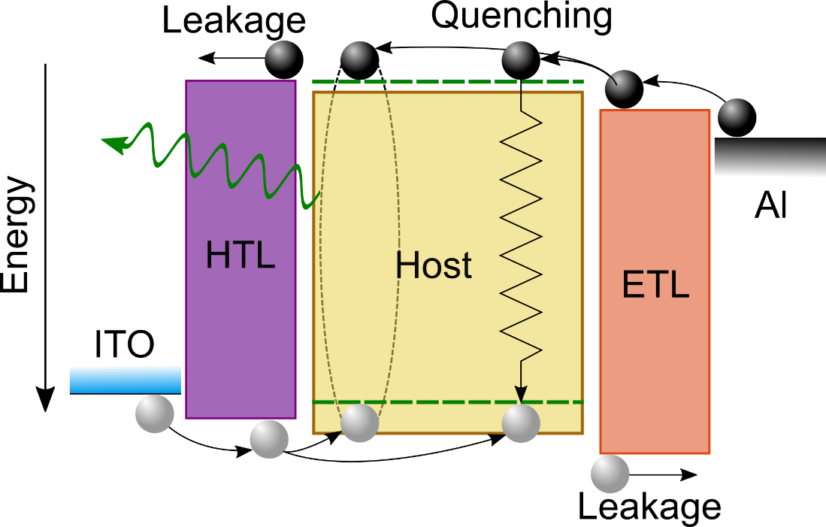
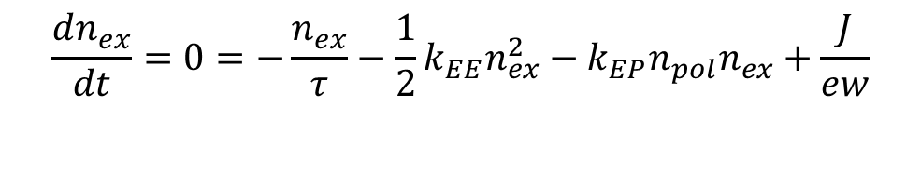
Exciton Kinetics
Key Processes:
Exciton Formation
From injected polarons
NOT instantaneous
Competitive with leakage
Exciton Recombination
Radiative emission
Competitive with quenching
Exciton Lifetime
Exciton-Polaron Quenching
$$\frac{dn_{ex}}{dt}=0=−\frac{n_{ex}}{τ}−\frac{1}{2}k_{EE}n_{ex}^{2}−k_{EP}n_{pol}n_{ex}+\frac{J}{ew}$$
Exciton-Exciton Annihilation
Exciton Formation
Need to include polaron dynamics

Slide 16
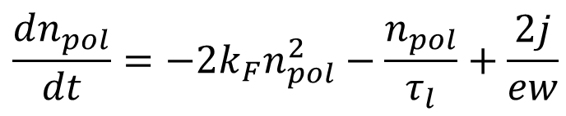
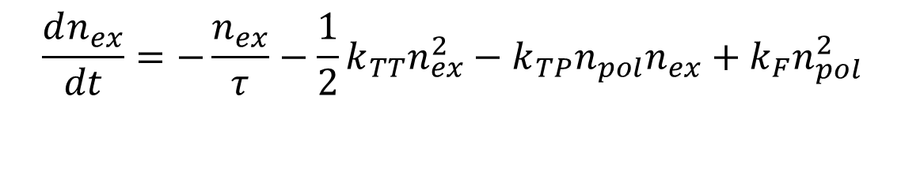
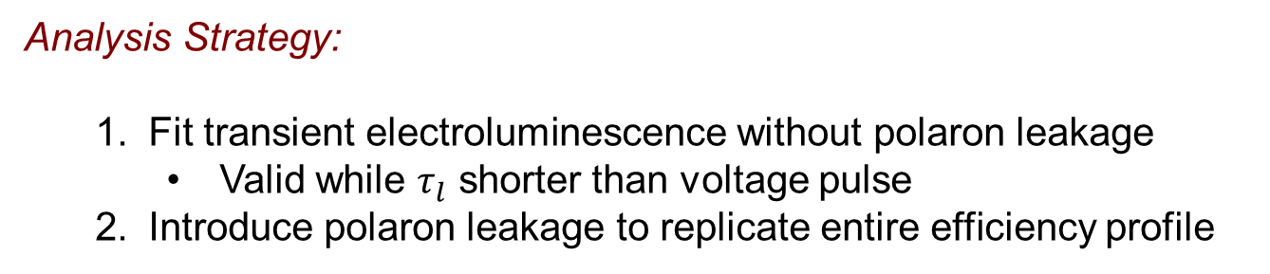
Model Summary
Exciton Lifetime
Triplet-Polaron Quenching
$$\frac{dn_{ex}}{dt}=−\frac{n_{ex}}{τ}−\frac{1}{2}k_{TT}n_{ex}^{2}−k_{TP}n_{pol}n_{ex}+k_{F}n_{pol}^{2}$$
Triplet-Triplet Annihilation
Exciton Formation
Exciton Formation
Polaron Injection
$$\frac{dn_{pol}}{dt}={−2k}_{F}n_{pol}^{2}−\frac{n_{pol}}{τ_{l}}+\frac{2j}{ew}$$
Polaron leakage
Analysis Strategy:
Fit transient electroluminescence without polaron leakage
Valid while $τ_{l}$ shorter than voltage pulse
Introduce polaron leakage to replicate entire efficiency profile

Slide 17
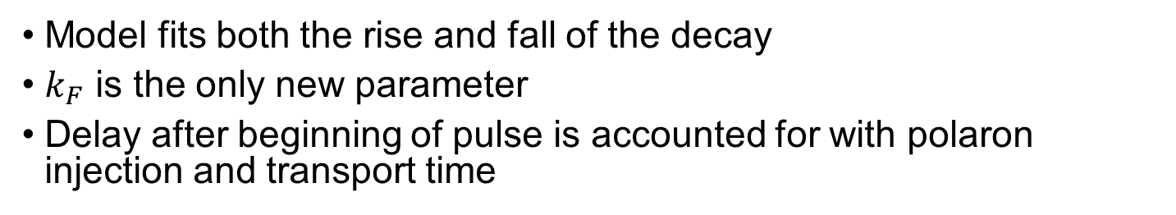
Transient Electroluminescence
Model fits both the rise and fall of the decay
$k_{F}$ is the only new parameter
Delay after beginning of pulse is accounted for with polaron injection and transport time

Slide 18
Transient Electroluminescence

Slide 19
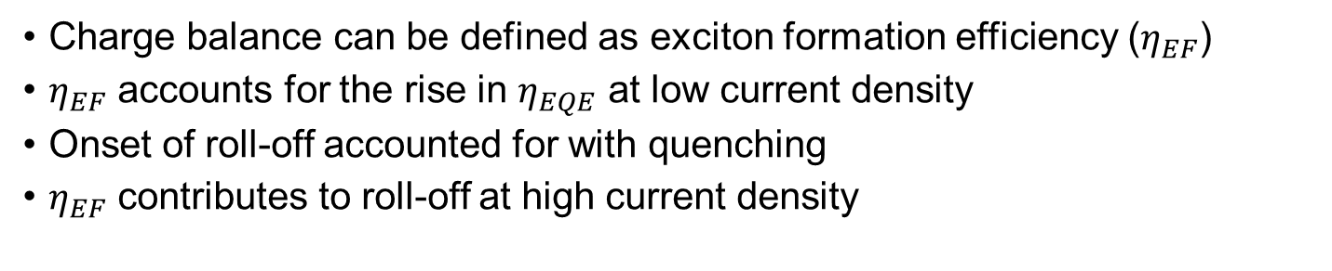
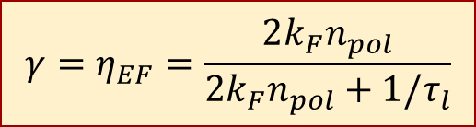
Deconstructing Efficiency
$$γ=η_{EF}=\frac{2k_{F}n_{pol}}{2k_{F}n_{pol}+1/τ_{l}}$$
Charge balance can be defined as exciton formation efficiency ($η_{EF}$)
$η_{EF}$ accounts for the rise in $η_{EQE}$ at low current density
Onset of roll-off accounted for with quenching
$η_{EF}$ contributes to roll-off at high current density

Slide 20
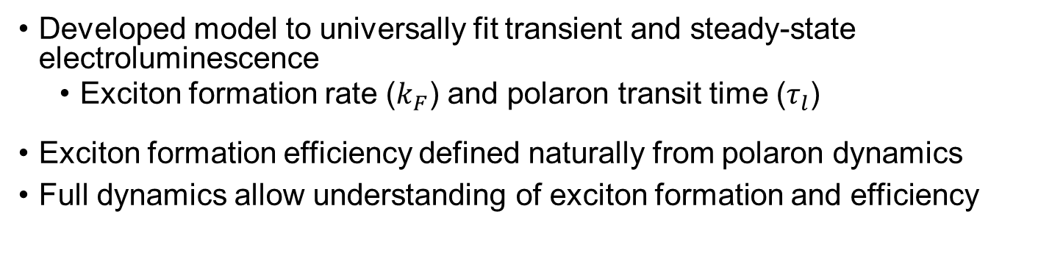
Summary
Developed model to universally fit transient and steady-state electroluminescence
Exciton formation rate ($k_{F}$) and polaron transit time ($τ_{l}$)
Exciton formation efficiency defined naturally from polaron dynamics
Full dynamics allow understanding of exciton formation and efficiency

Slide 21
Outline
OLED background
Overview and applications
Operation
Goals
Device Physics
Efficiency roll-off at high current
Transient electroluminescence
Analytical formalism for “charge balance”
Lifetime and Test Engineering
Degradation as efficiency loss
Extracting dynamics
Design rules for long lifetime
Data Engineering
Measurement system integration
Analysis Capabilities
Machine Learning

Slide 22
OLED Degradation
OLED degradation remains a key area for improvement, especially in blue- and white-emitting devices
Difficult to optimize due to long testing time, even when accelerated
Minimal extracted data
Degradation mechanisms poorly understood - Convolution of dynamics
Hershey et. al. Appl. Phys. Lett. 2017, 111, 113301.

Slide 23
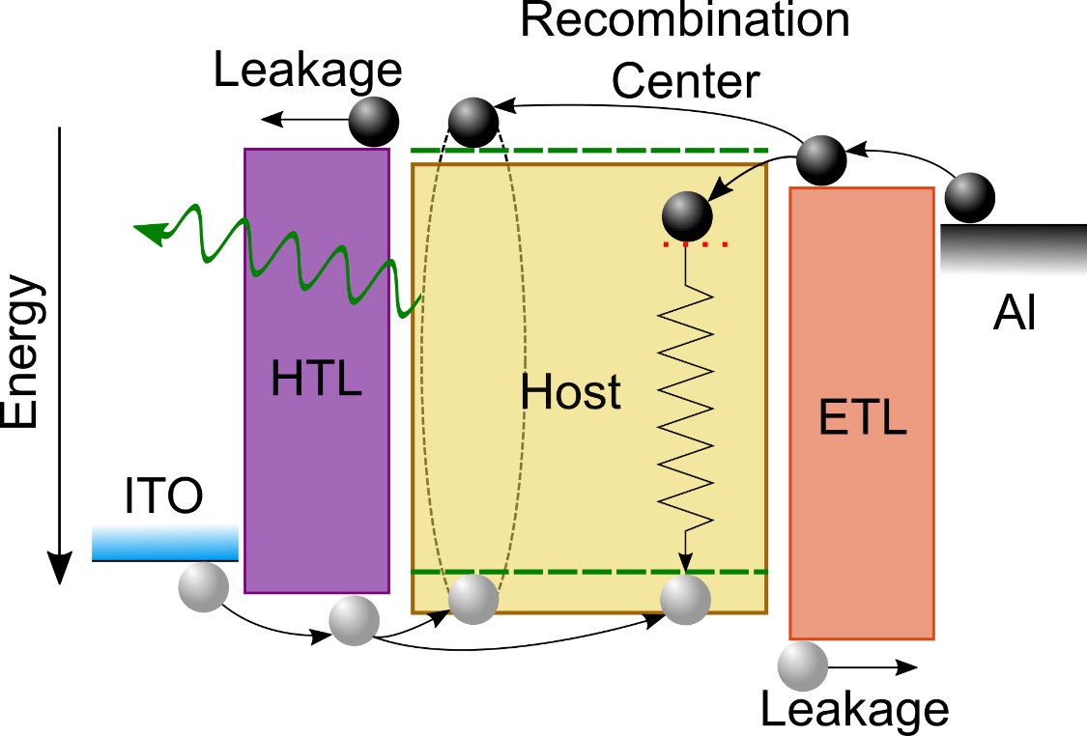

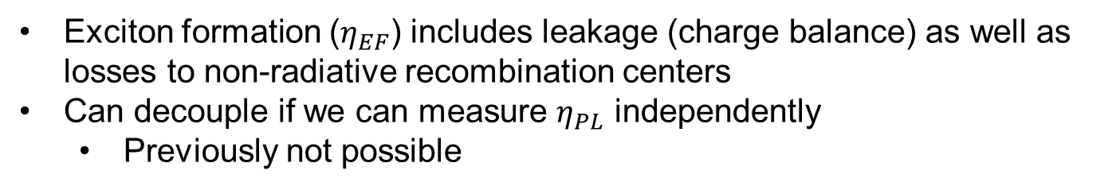
Decoupling Efficiency Losses
Luminance loss is loss in efficiency
η$EQE\left(t\right)$=η_{OC}χ$x \text{η}PL\left(t\right) x \text{η}EF\left(t\right)$
Exciton formation ($η_{EF}$) includes leakage (charge balance) as well as losses to non-radiative recombination centers
Can decouple if we can measure $η_{PL}$ independently
Previously not possible

Slide 24
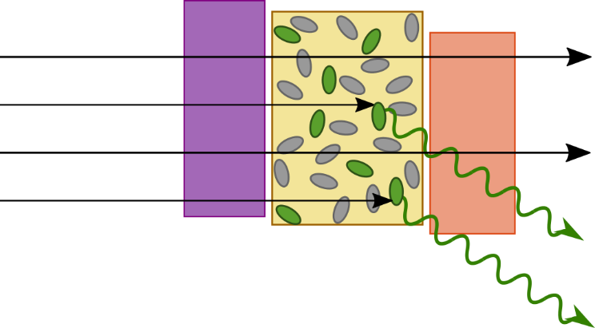
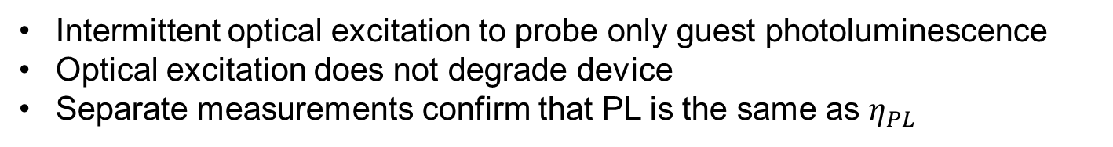
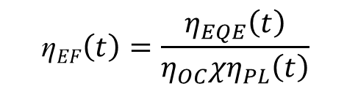
Deconstructing OLED Degradation
PL
EL
Continuous EL
(10 minutes)
PL (~20 seconds)
EL Lifetime (Hours)
$$\text{η}EF\left(t\right)=\frac{η_{EQE}\left(t\right)}{{η_{OC}χη}_{PL}\left(t\right)}$$
Intermittent optical excitation to probe only guest photoluminescence
Optical excitation does not degrade device
Separate measurements confirm that PL is the same as $η_{PL}$

Slide 25
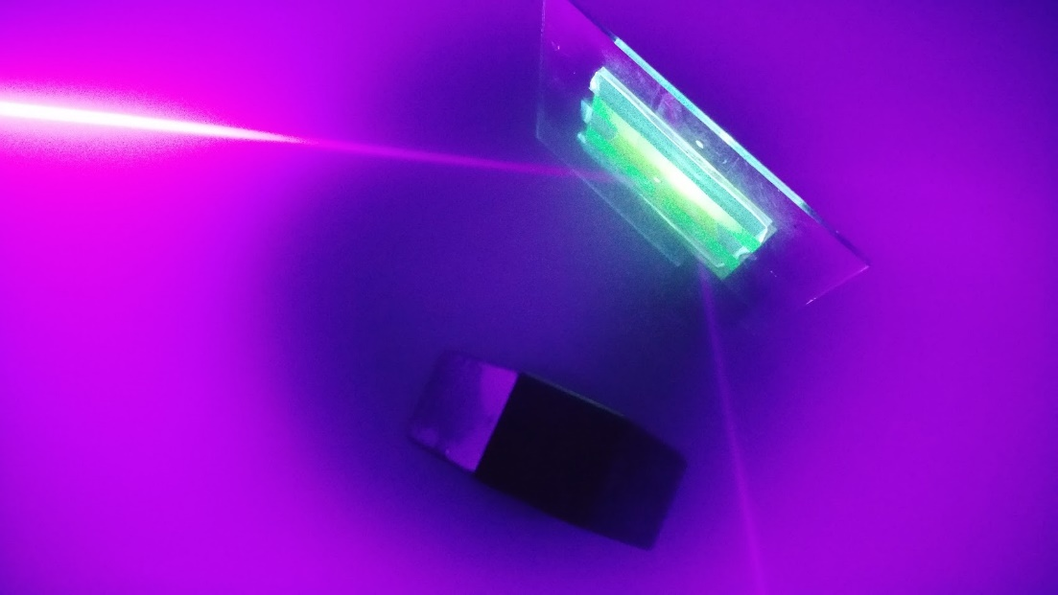
Deconstructing OLED Degradation
PL
EL
Continuous EL
(10 minutes)
PL (~20 seconds)
EL Lifetime (Hours)
$$\text{η}EF\left(t\right)=\frac{η_{EQE}\left(t\right)}{{η_{OC}χη}_{PL}\left(t\right)}$$
Intermittent optical excitation to probe only guest photoluminescence
Optical excitation does not degrade device
Separate measurements confirm that PL is the same as $η_{PL}$

Slide 26
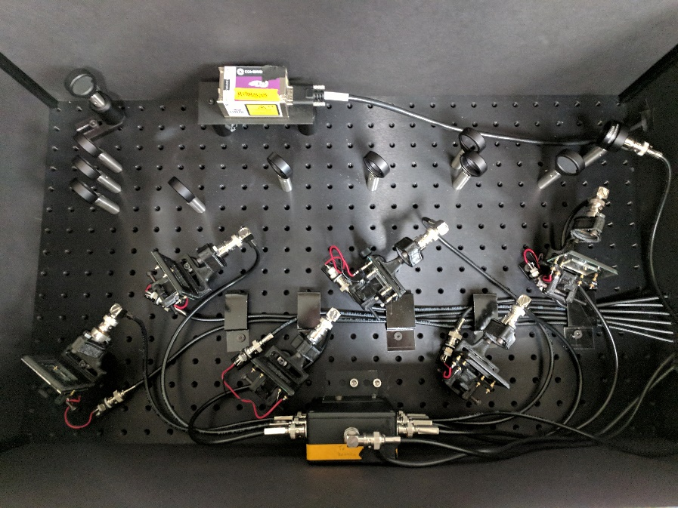
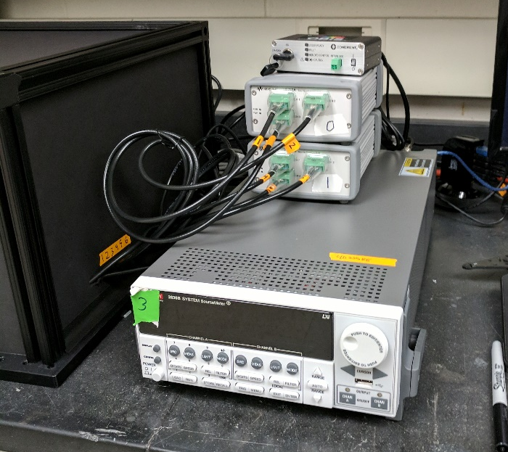
Deconstructing OLED Degradation
Laser Controller
Laser
Laser Power Meter
Current Sources
Laser Optics
Device Holders
Measurement Unit
Detection Switcher
Laser signal is split among six devices
Software synchronizes EL and PL measurements and controls current
Lifetime is within error with and without PL breaks

Slide 27
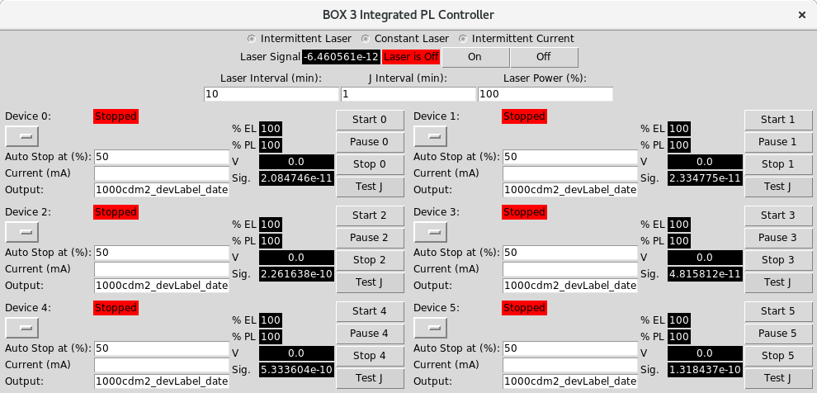
Software Interface
Expansive software allows for multiple testing conditions
Constant current, optical degradation, intermittent laser probes, etc
Configurable to multiple hardware setups
Written in Python
Stores results in searchable database

Slide 28
Deconstructing OLED Degradation
Additional data acquired from same test on same device
Exciton formation and emission losses can be separated using a single run
Device limitations are immediately identified!
Hershey et al., Appl. Phys. Lett. 2017, 111, 113301.

Slide 29
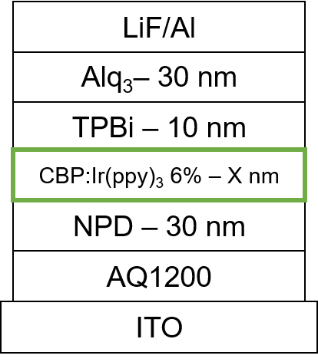
Application to Device Optimization
Investigating EML thickness dependence of lifetime
Significant lifetime improvement for 30 nm
PL loss is mostly independent of EML thickness
Suggests minimal change in exciton density
Similar recombination zone width
Degradation in exciton formation determines time scale of EL decay

Slide 30
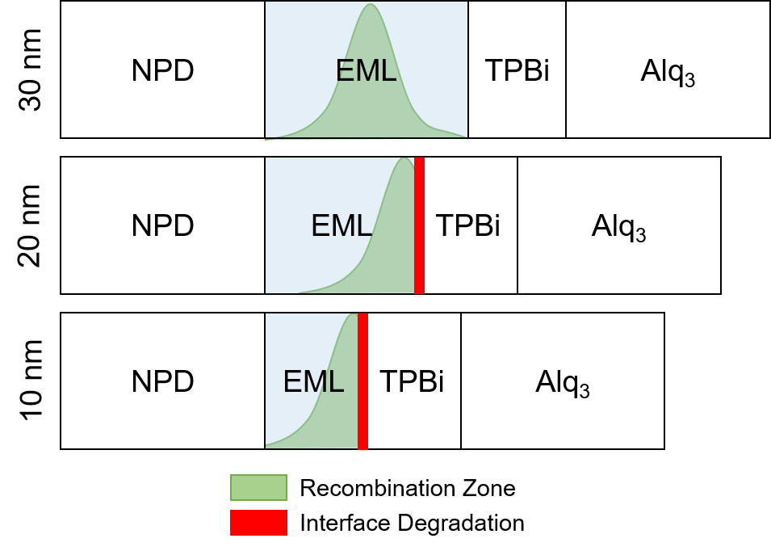
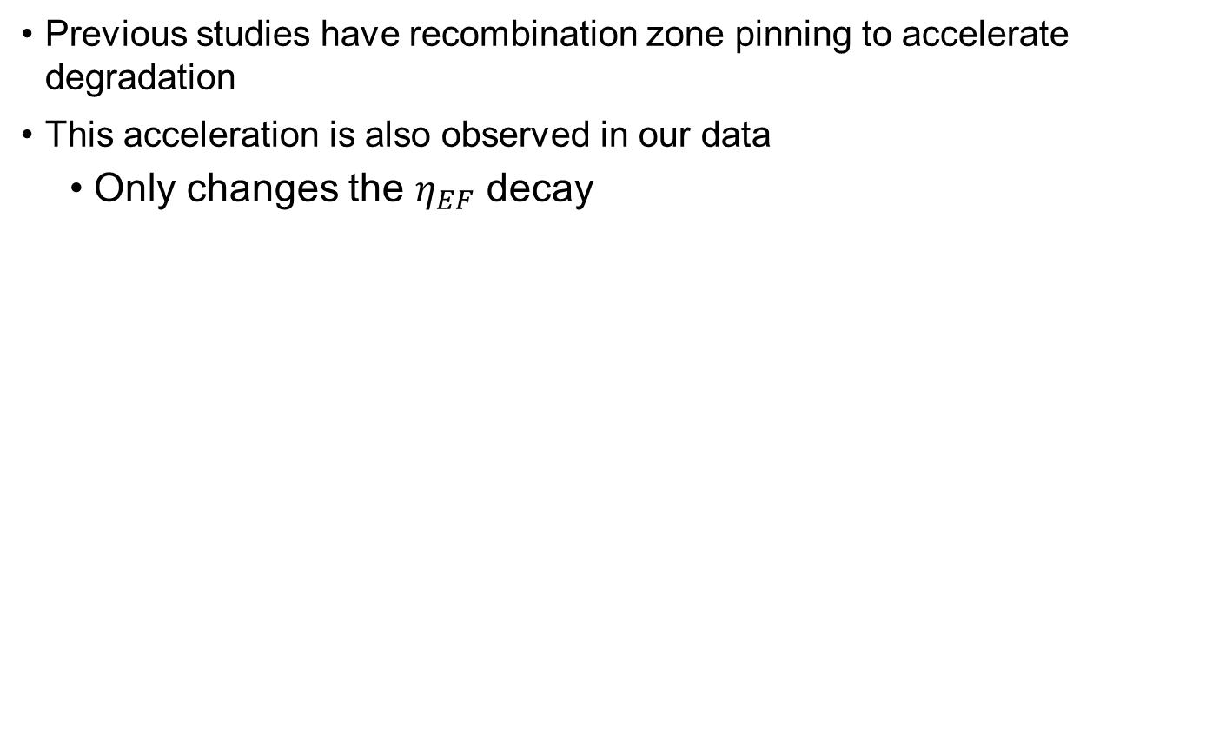
Probing the Recombination Zone
Measurements have shown that the recombination zone is pinned at the TPBi interface in the 10 and 20 nm EML devices
Previous studies have recombination zone pinning to accelerate degradation
This acceleration is also observed in our data
Only changes the $η_{EF}$ decay

Slide 31
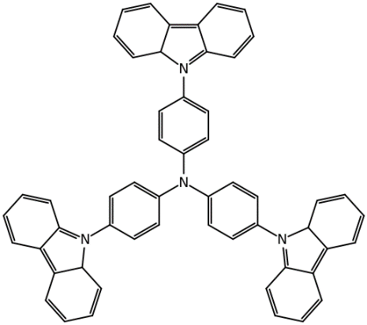
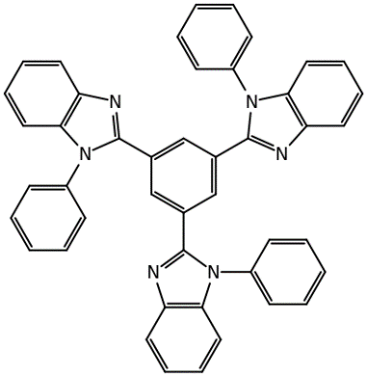
Technique Applications
PL degradation scales with thickness
Exciton density scales with EML thickness
Recombination zone causing lifetime enhancement
TPBi
TCTA
LiF + Al
TPBi 20 nm
TCTA:TPBi:Ir(ppy)₃ (5%)
X nm
TCTA 20 nm
AQ1200/ITO/Glass
J. S. Bangsund, K. W. Hershey, R. J. Holmes, ACS Appl. Mater. Interfaces 2018

Slide 32
Technique Applications
Collaboration with Dow
Improved performance from cohost system
Often due to more balanced charge transport
In this system, Host A is less conductive for both carriers
Lifetime is a balance of recombination zone and interfacial effects
Previous two studies demonstrate end points of this scale
K. W. Hershey, J. S. Bangsund. 2018. (In Preparation)

Slide 33
Summary
Developed decoupling technique for lifetime
Separate parameters help design process
Recombination zone important for degradation
RZ position
RZ width and exciton density

Slide 34
Outline
OLED background
Overview and applications
Operation
Goals
Device Physics
Efficiency roll-off at high current
Transient electroluminescence
Analytical formalism for “charge balance”
Lifetime and Test Engineering
Degradation as efficiency loss
Extracting dynamics
Design rules for long lifetime
Data Engineering
Measurement system integration
Analysis Capabilities
Machine Learning

Slide 35
Data Collection Techniques
Our lab collects large datasets
Fewer experiments
Lots of data along with it
Difficult to compare and keep track
I have used my background to improve data collection and usage
Integrated collection and organization into measurement tools
Data storage in database
Reworked analysis protocol
Enabled machine learning applications

Slide 36
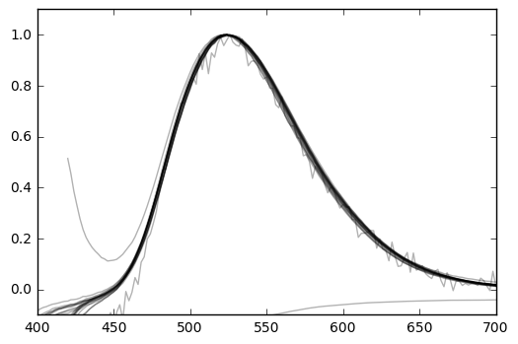
Data in Our Lab
Growth Information
Layer stack of materials
Lab conditions
Characterize devices/films
Spectral
Current-Voltage
Lifetime Testing
Testing conditions
X vs Time

Slide 37
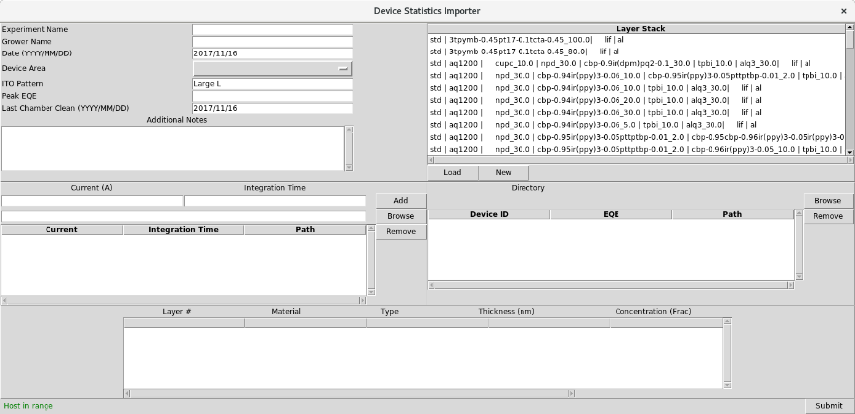
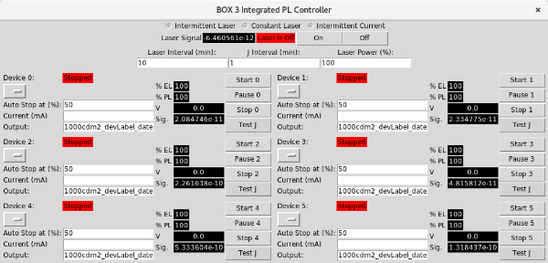
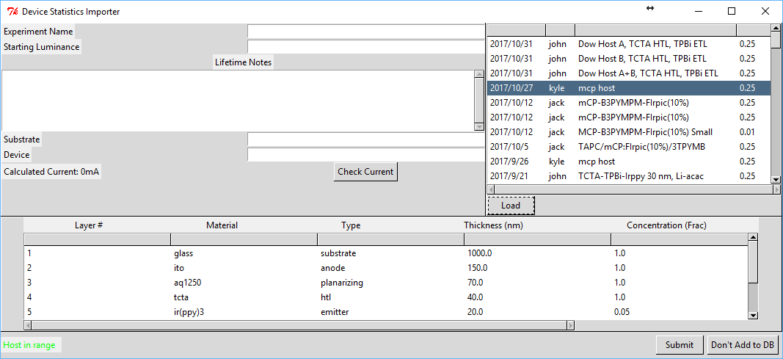
Data in Our Lab
Characterize devices
Experiment details and data collected within measurement software
Analyzed results immediately available through web interface
Lifetime Testing
Integrates with device data to set driving current
Instrument Uploaders
Allows easy integration of data at time of testing

Slide 38
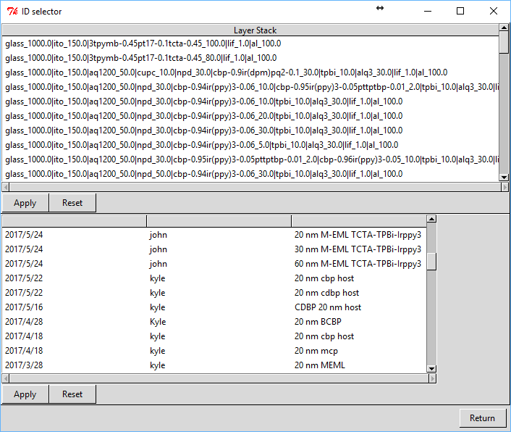
Comparing Data
Architecture and growth browser allow easy comparison of datasets
Plots common measurements

Slide 39
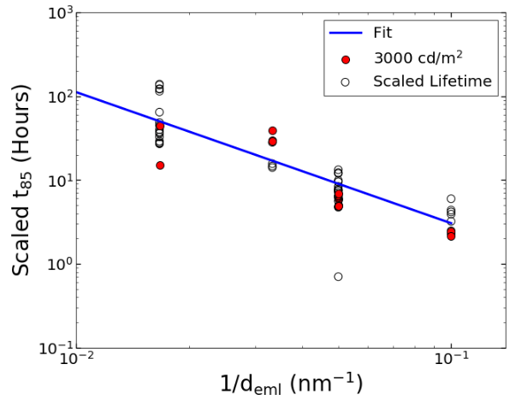
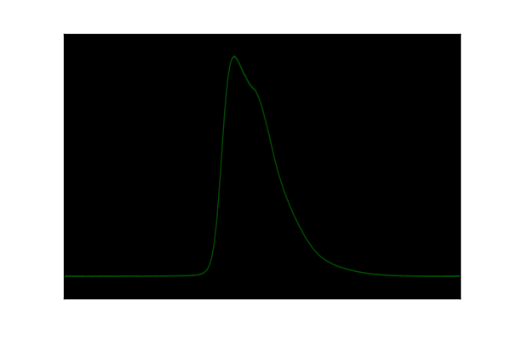
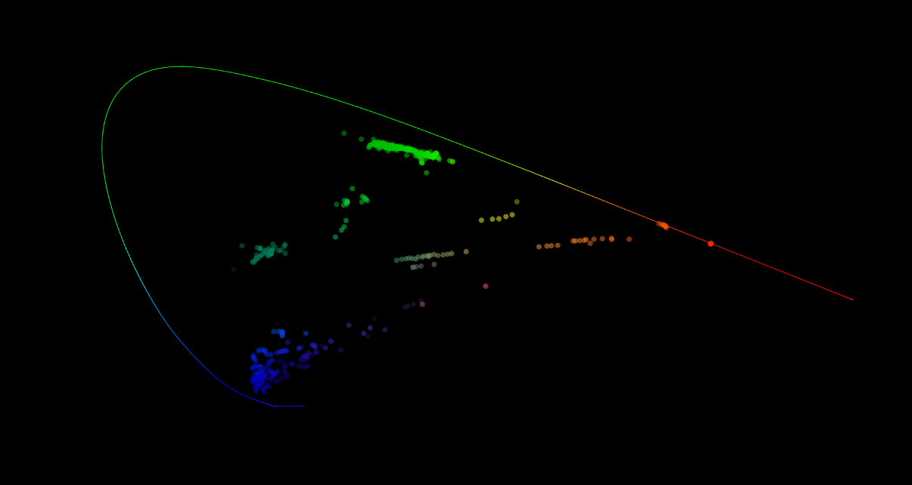
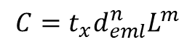

Programmatic Data Access
All data searchable by key parameters
Trend recognition / Model development
Lifetime has functional dependence on exciton density
Matches luminance and $d_{eml}$
Visualization
Less useful, but still cool
$$C=t_{x}d_{eml}^{n}L^{m}$$
J. S. Bangsund, K. W. Hershey, R. J. Holmes, ACS Appl. Mater. Interfaces 2018

Slide 40


Machine Learning
Bad pixel recognition
Used pre-labeled “bad” devices to recognize unrepresentative scans
Spectral recognition
Trained on emitters known to our group
What is this unknown molecule:
A 80% match
B 20% match
Want to expand to recognizing impurity molecules and impure spectra
A
B

Slide 41


Conclusions
Device Physics
Developed understanding of charge dynamics
Quantified definition of exciton formation efficiency
Lifetime and Test Development
Developed method for decoupling degradation
Manufactured hardware and software to enable test
Used method to understand lifetime improvements
Data Engineering
Collected lab data into database using testing software suite
Revolutionized data analysis
Incorporating machine learning

Slide 42
Questions?
Kyle Hershey
kwhershey@gmail.com

Slide 45

Archive Search Tools
All spectral measurements previously done by group imported
Searchable from web interface
Easy access to reference data
Intensity
Wavelength (nm)

Slide 46
Conclusions
Unification of transient / steady-state dynamics
Developed understanding of charge dynamics
Quantified definition of exciton formation efficiency
Decoupling operational lifetime
Developed method for decoupling degradation
Used method to understand lifetime improvements

Slide 47



Correctly Probing $η_{PL}$
For a measurement of PL intensity to reflect $η_{PL}$, exciton generation (guest absorption) must be constant during degradation:
Can confirm with exciton decay
kinetics:
$$\frac{η_{PL}(t)}{η_{PL}(0)}=\frac{PL(t)}{PL(0)}\frac{α(0)I(0)}{α\left(t\right)I(t)}$$
$$\frac{PL\left(t\right)}{PL(0)}=\frac{τ(t)}{τ(0)}=\frac{η_{PL}(t)}{η_{PL}(0)}$$

Slide 48



Accounting for Polaron Dynamics
More complete picture requires polaron dynamics
Exciton Formation
Electrons and holes may combine to form an exciton
Spatially averaged exciton formation rate
$k_{F}$ is exciton formation rate constant
Polaron Loss
Polarons have a finite residence time due to transit through the emissive layer
$${{\left[\frac{dn_{ex}}{dt}\right]}_{gen}=k}_{F}{\left[n_{pol}\right]}^{2}$$
$${\left[\frac{dn_{pol}}{dt}\right]}_{loss}=−\frac{n_{pol}}{τ_{l}}$$
K. W. Hershey, R. J. Holmes, J. Appl. Phys. 2016, 120, 195501.

Slide 49

Deconstructing Efficiency
Previous model fit normalized roll-off
I used polaron leakage ($τ_{l}$) to create exact fit
Polaron leakage is not arbitrary
Agrees with carrier drift through emissive layer under applied field

Slide 50

Initial Attempts
Need to measure $η_{PL}$
Excite device before and after using 405 nm laser
Only probes emitter
Luminance ratio is loss in $η_{PL}$
Each curve requires one device for every point
Error
Sample to sample
Measurement reproducibility
Want all information from one device without moving
PL
EL
PL
EL
PL
EL

Slide 51





Application to Device Optimization
How can we use this method to understand device performance and optimization?
Increase in lifetime with EML thickness - What is causing this improvement?
TPBi
Ir(ppy)₃
NPD
CBP
AlQ₃

Slide 52
Application to Device Optimization
How can we use this method to understand device performance and optimization?
Increase in lifetime with EML thickness - What is causing this improvement?

Slide 53
Application to Device Optimization
1000 cd/m²
5000 cd/m²
Recombination loss is mostly independent of EML thickness
Invariance suggests minimal change in exciton density
Similar recombination zone width
Degradation in exciton formation determines time scale of EL decay

